Slide 1
Remote Access Laboratory Guide
Plant growth in solutions of nanoparticles
In this exercise, you will:
Create a nanoparticle solution
Gain experience in nanoscale characterization
Published: Dec 2016, Rev. 1

Slide 2
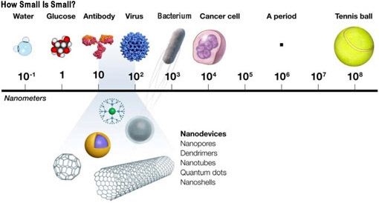
Background
Nanomaterials are generally classified as those materials having at least one dimension less than 100 nm, which leads to the possibility that they can exhibit different properties than their respective bulk materials.
https://www.teachengineering.org/lessons/view/uoh_nano_lesson01

Slide 3
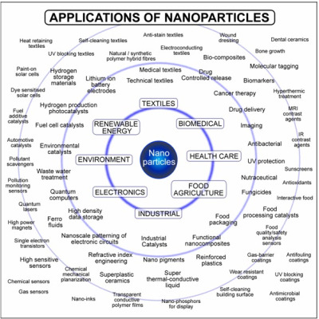
Background
Engineered nanomaterials (ENMs) are materials created with nanoscale dimensions. There are over 1,800 consumer products reported to include ENMs. For example:
  1. Tennis racquets can contain carbon nanotubes to increase their strength.
  2. Eco-fabric contains carbon nanoparticles.
  3. Sunscreens contain either zinc oxide or titanium oxide nanoparticles to block the ultraviolet rays of the sun yet minimize the white color of the sunscreen on skin.
  4. Clothing items with silver nanoparticles that resist bacterial growth.
http://nanoparticle-blog.com/

Slide 4
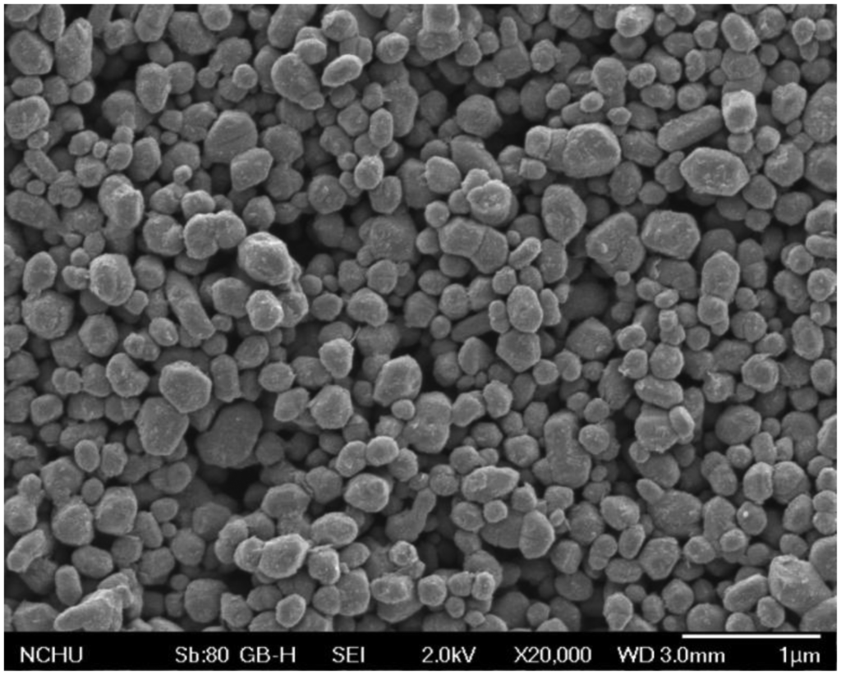


Background
Two of the top ten ENMs in terms of both the number of commercial products and estimated worldwide production are ENMs made from silicon dioxide (SiO2) and zinc oxide (ZnO).
Although there have been great advances in the production and uses of ENMs, their impacts on health and the environment are not completely clear and often depend on the transport and exposure pathways as well as the subjects into which ENMs enter. This complexity regarding nanotoxicity often leads to seemingly conflicting conclusions, causing confusion among scientists and especially among non-scientists. In one example, recent reports in the media have focused on the possible nanotoxicity of titanium dioxide (TiO2) nanoparticles (NPs), a component in sunscreens and the confections of Dunkin Donuts. Dunkin Donuts has since announced that it is removing all TiO2 from its products.
http://phys.org/news/2015-03-dunkin-donuts-ditches-titanium-dioxide.html
MDPI.com
http://www.nanotechmag.com/titanium-dioxide-nanoparticles-2/

Slide 5

Background
Given the massive industrial quantities of SiO2 and ZnO ENMs being produced,6 it is important to determine the impacts of these materials on the environment. One important aspect of their interactions with plants–via accumulation in soils and subsequent entry into plants–is through the application of biosolids, sewage sludge that has been treated, to agricultural fields. In the U. S., approximately 3.36 million tons of biosolids (representing 60% of the sewage sludge in the U. S.) are applied to over 70 million agricultural acres annually as fertilizer.7 The concentration of zinc in a sample of biosolids was measured to be 620 mg Zn/kg dry mass of biosolid, still 10 times less than the limit set by the Environmental Protection Agency but a factor of 30 times more enriched than typical soil8 (and a factor of more than 30 times more concentrated than some of the solutions used in this experiment).
With all of these nanoparticles being produced and entering the environment, it seems reasonable to ask how the nanoparticles will affect the environment. This experiment presents a simple method for determining the effects in a fairly controlled way. Four different types of nanoparticles are used to see the effects of different types of nanoparticles on the growth of the mung beans as compared to mung beans grown in pure water. The experiment can be run with more or fewer types of nanoparticles.
http://cvilletomorrow.typepad.com/charlottesville_tomorrow_/biosolids/

Slide 6
Background
For this lab exercise, you will need the following :
100 mung beans
20 petri dishes with lids
20 mL scintillation vial w/ 20 mg of ZnO nanoparticles in Nanopure water
20 mL scintillation vial w/ 20 mg of SiO2 nanoparticles in Nanopure water
20 mL scintillation vial w/ 20 mg of Single Wall Carbon Nanotubes (SWNT) nanoparticles in Nanopure water
20 mL scintillation vial w/ 20 mg of Multi Wall Carbon Nanotubes (MWNT) nanoparticles in Nanopure water
Nanopure water for dilution (distilled or deionized water will also work)
Five 1 L volumetric flask
Sonicator
Five funnels for transfer of the stock solution into the 1 L volumetric flask
Permanent Markers
Colored lab tape
Large plastic tray (for holding the petri dishes)
Butcher paper (for labeling the positions of each petri dish on the tray)

Slide 7
Procedure: (prior to lab)
Prepare concentrated nanoparticle suspensions of each kind of nanoparticle.
  Measure 20 mg of each nanoparticle. Place in 20 mL scintillation vials.
  These solutions are diluted during the lab to a total volume of 1 L using a 1 L volumetric flask and the Nanopure water provided. These solutions must be sonicated for 15 minutes immediately prior to being poured into the petri dishes.
Install the free software ImageJ. (https://imagej.nih.gov/ij/)

Slide 8
Procedure:
Preparing the Mung Beans
Obtain 5 petri dishes with lids. Make sure that they are clean by washing them with soap and water. Rinse them in Nanopure water and dry them off with paper towels. Label each petri dish with the type and concentration of the nanoparticles and your group number:
  Nanopure water
  20 mg/L SiO2
  20 mg/L ZnO
  20 mg/L Single Wall Carbon Nanotubes (SWNT) or other type of nanoparticle
  20 mg/L Multi Wall Carbon Nanotubes (MWNT) or other type of nanoparticle
Place 5 mung beans in each petri dish.
Because the entire experiment will take about 1 L of each type of nanoparticle solution, each group will dilute one solution. Ask the instructor which type of nanoparticle your group has been assigned. Make a 1L solution of that type of nanoparticle using a volumetric flask, a scintillation vial with your type of nanoparticle (already prepared), a funnel, and Nanopure water. Use Nanopure water to rinse out the vial and ensure complete transfer of the nanoparticles into the 1 L volumetric flask.

Slide 9
Procedure:
Preparing the Mung Beans
Place your group's petri dishes on the proper place on the large plastic tray. Label the butcher paper with the type and concentration of the nanoparticles and your group number. When all groups have completed this part, we will take the tray to a room in which the lights will be on 24/7 for the length of the experiment. Under no circumstances should the light be turned off in this room for the length of the experiment.
Fill the sonicator 3/10 full with nanopure water. Sonicate each solution for at least 15 minutes directly before using it to fill each petri dish.
Pour each of the nanoparticle solutions into the appropriate petri dishes so that the mung beans are completely covered in solution but not so filled that the petri dish will spill easily.

Slide 10
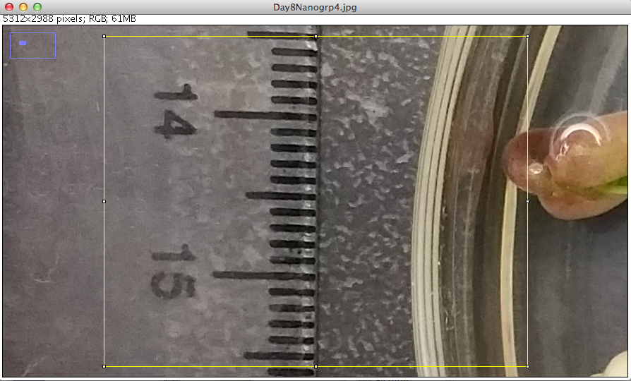
Procedure:
Calibrate measurements
Obtain access to a computer. Open the software ImageJ. Within ImageJ, open the file Day8Nanogrp4.jpg. You may also use your own laptop, but you will have to download ImageJ and obtain the image Day8Nanogrp4.jpg from your instructor
Zoom in on a part of the ruler such that 1 cm takes up at least half of the screen. The easiest way to do this is to draw a rectangle using the rectangle tool from the tools palette. Then go to Image → Zoom → To selection. Screen shot of zoomed image:

Slide 11

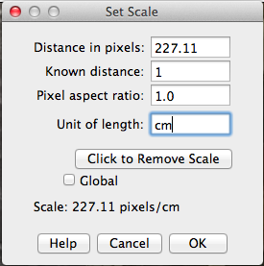
Procedure:
Calibrate measurements
Click on the straight line tool. Draw a straight line from the middle of one cm marker to the middle of the next cm marker. Screen shot (the line is light yellow and thin- so it's hard to see but it is there):
Choose Analyze → Set Scale …
The number of pixels for your line will appear in the "Distance in pixels" box. It is equal to 1.00 cm.

Slide 12
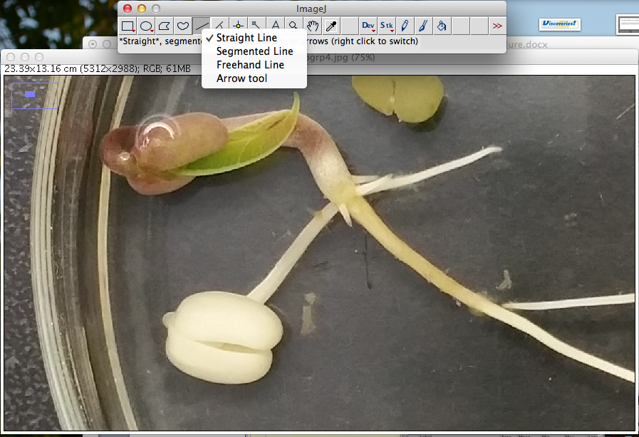
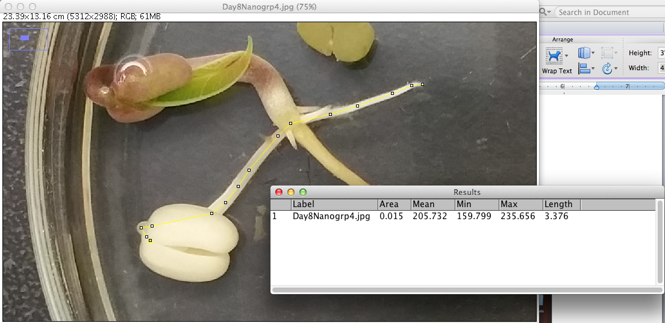
Procedure:
Measuring sprout growth
Zoom out to see entire image. Zoom in to each individual mung bean sprout. Use the "Segmented Line" to trace the length of the mung bean growth. When you are confident that you have the correct line, go to Analyze → Measure. In the Results window, it will show you all of the characteristics of the line, including the "Length" in cm.

Slide 13
Procedure:
Table 1
Put your results in a Table 1. Compare
your results with other students to
ensure consistency.
Obtain one digital SEM image of each type of nanoparticle (ZnO: less100nmZnONPs_07.tif, SiO2¬: SiO2onSi1020nm30minsonic_04.TIF) from your instructor. The procedure for measuring the nanoparticles on the SEM images is the same as for measuring the growth of the mung beans, except that the number of pixels for the scale bar is always set to 264 pixels. It is equal to the length of the scale bar printed on the image. Determine the size of each nanoparticle in two perpendicular dimensions if possible). Do at least 20 measurements (10 nanoparticles) for each type of nanoparticle and put the results in Table 2.
Obtain one digital SEM image of each type of nanotube (single walled: SWNTs1nm30minsonic_04.TIF, multi walled: MWNTs30minsonic10nm_11.TIF). Determine the width of each type of nanotube. Do at least 20 locations of varied position for each type of nanotube and put the results in Table 3.
File Name: Day8Nanogrp4.jpg Conversion: _____________ pixels = 1 cm
Date | Group | Bean | SiO₂
10/24/14 | 4 | 1
 |  | 2
 |  | 3
 |  | 4
 |  | 5

Slide 14
Table 2
Table 3
Filename: less100nmZnONPs_07.tif |  | Filename: SiO2onSi1020nm30minsonic_04.TIF
Type of NP: ZnO |  | Type of NP: SiO₂
Scale Factor: _____ pixels = ____nm |  | Scale Factor: _____ pixels = ____nm
1 |  | 1
2 |  | 2
3 |  | 3
4 |  | 4
5 |  | 5
6 |  | 6
7 |  | 7
8 |  | 8
9 |  | 9
10 |  | 10
11 |  | 11
12 |  | 12
13 |  | 13
14 |  | 14
15 |  | 15
16 |  | 16
17 |  | 17
18 |  | 18
19 |  | 19
20 |  | 20
Filename: SWNTs1nm30minsonic_04.TIF |  | Filename: MWNTs30minsonic10nm_11.TIF
Type of NP: SWNT |  | Type of NP: MWNT
Scale Factor: _____ pixels = ____nm |  | Scale Factor: _____ pixels = ____nm
1 |  | 1
2 |  | 2
3 |  | 3
4 |  | 4
5 |  | 5
6 |  | 6
7 |  | 7
8 |  | 8
9 |  | 9
10 |  | 10
11 |  | 11
12 |  | 12
13 |  | 13
14 |  | 14
15 |  | 15
16 |  | 16
17 |  | 17
18 |  | 18
19 |  | 19
20 |  | 20

Slide 15
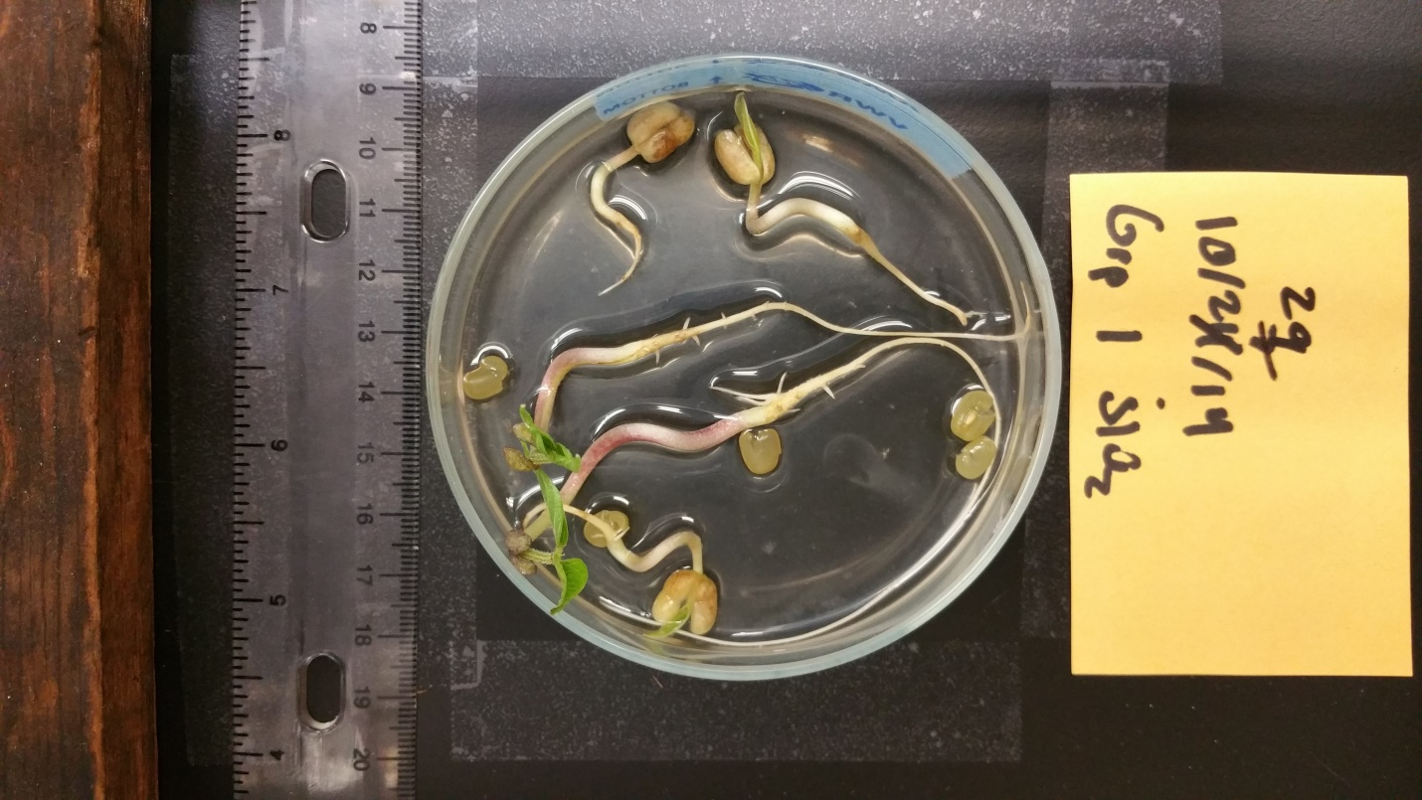
Procedure:
Taking photos of Mung Bean sprouts
In the controlled environment we will be taking photos of each petri dish each day for 14 days.
There will be a station that is already set with exact positions that is needed to take the pictures and obtain measurements.
There will be a ruler with at least centimeter markings placed right next to the mung beans. There will also be blank index cards that will have empty spots open for the group number, nanoparticle solution and the date. These must be in the view of the camera to obtain good results.
For example the set up should be similar to this:

Slide 16
Procedure:
Taking photos of Mung Bean sprouts
In the Petri dishes some of the nanoparticle solutions may have receded. If so then sonicate the nanoparticle solutions and then refill until the tops of the mung beans are completely covered but not so filled that the petri dish will spill easily.
In the image above there is a platform that a camera phone may sit on so that the camera will be in a stationary position, which minimizes fuzziness and maximizes a controlled phone environment so that each picture can be taken in the same way.
Now using a blank flash card, write down the date, group number, and which nanoparticle solution is being used. Place that right next to the mung bean petri dish.
Place a ruler at the opposite end of the index card next to the petri dish. It is critical that the ruler is in the plane of the picture, otherwise no measurements can be used because there is no known distance.
Now place your camera phone on top of the apparatus and turn on the camera application.
Make sure the picture is as clear as possible, and take a similar photo each day. Make sure to save the photo to your memory in the phone.
Send each picture as you take it to your email account with proper labeling so you can find it later.
Repeat #6-10 for all petri dishes. You will send a total of 20 pictures.

Slide 17
Procedure:
Analyzing sprout growth
On a computer upload your saved photos of all of the mung beans into a known saved folder.
Open the image in ImageJ.
Use the calibration procedure to set the measurement scale.
Zoom out to see entire image. Zoom in to each individual mung bean sprout. Use the "Segmented Line" to trace the length of the mung bean growth. When you are confident that you have the correct line, go to Analyze → Measure. In the Results window, it will show you all of the characteristics of the line, including the "Length" in cm.
Put your results in Table 4. Then put your results into an Excel spreadsheet. Calculate the average and standard error for each group of data.
On a separate sheet note characteristics that have changed every day, such as appearance of leaves or a fungal growth in the petri dish, or even shoot color. This experiment will run for 14 days, but mishaps can happen just be sure to keep a record of everything that you do. After all of the results finished then a curve will get generated and we will determine if the experiment is a success.

Slide 18
Table 4
Date: | Group | Bean | Nanopure | ZnO | SiO₂ | SWNT | MWNT
 | 1 | Scale Factor (SF)
 |  | 1
 |  | 2
 |  | 3
 |  | 4
 | Group | 5
 | 2 | Bean | Nanopure | ZnO | SiO₂ | SWNT | MWNT
 |  | SF
 |  | 1
 |  | 2
 |  | 3
 | Group | 4
 | 3 | 5
 |  | Bean | Nanopure | ZnO | SiO₂ | SWNT | MWNT
 |  | SF
 |  | 1
 |  | 2
 | Group | 3
 | 4 | 4
 |  | 5
 |  | Bean | Nanopure | ZnO | SiO₂ | SWNT | MWNT
 |  | SF
 |  | 1
 |  | 2
 |  | 3
 |  | 4
 |  | 5

Slide 19
Remote Access Connection Instructions
What makes these labs different and unique from other classroom experiments is that we have incorporated a section in each activity to remotely characterize your samples from your classroom. Remote access to a variety of characterization tools can enhance the visualization of nano-related concepts by allowing students to see the effects of their work first hand. You can choose to mail your samples to our facility to be analyzed at a later date or you can use our samples that have been processed using the same procedure. Please use the following steps to successfully complete a remote session.
Request a remote lab session specifying pertinent information such as: the day, the time, and the instrument you are interested in using by visiting our web site http://nano4me.org/ Go to the Educator’s tab and select the Remote Access tab in that section. You will see the list of partners with the instruments provided to chose from.
You will be contacted by a Remote Access staff member to set up a test run to ensure you are set up properly and have the required infrastructure.
Send samples or verify the in-house sample you would like us to prepare and load for characterization. Send your samples to the Remote Access center that you chose on your request.
There are two communications soft-ware packages, that will allow us to communicate instructions and answer questions during the session.
  Zoom: You can obtain a free download at: https://www.zoom.us/
  TeamViewer: You can obtain a free download at: https://www.teamviewer.com/en/index.aspx

Slide 20
Remote Access Connection Instructions
You will need:
  Computer with administrator access to install plug-ins and software
  An internet connection
  Speakers
  Microphone
  Projector connected to the same computer
  Web browser (Firefox preferred)
During the test run you can refer to this guide to perform the following steps, but it’s very important that you only proceed with these steps during your scheduled times. You may interfere with other remote sessions and potentially damage equipment if you log in at other times.
  Open and logon to your Zoom/Team-viewer account. You will be given the access code to enter at the time of your test and then again during the remote session.
    If you are using the Zoom software, Remote Access staff will give you the access code.
    If you are using the Team-viewer software, Remote Access staff will give you the ID & password.
  You should soon see the Remote Access desktop and at this point you can interact with the icons on the screen as if it were your desktop.
  Switch to full screen mode by selecting the maximize screen option in the top right corner of the screen.
  Upon completion of the session, move your mouse to the top right corner of the screen, and click on the X to disconnect the remote session. It will ask if you want to end the remote session. Click Yes.

Slide 21
Author and Editor References
This remote access laboratory was created thanks to work done primarily at Pasadena City College, Pasadena CA. Two workshops were held at PCC in Aug 2015 and Aug 2016. Contributors to this the creation of this laboratory were:
  William J. W. Miller Sacramento City College
  millerw@scc.losrios.edu
  Jared Ashcroft Pasadena City College
Editing into RAIN Format was completed by:
  Beth Last The Pennsylvania State University

Slide 22



References and Supplemental Material
The Nanotechnology Applications and Career Knowledge (NACK) Center was established at the Penn State College of Engineering in September 2008 through the National Science Foundation (NSF) Advanced Technological Education program.
Please contact a NACK representative today to assist you in increasing the awareness of nanotechnology and education related opportunities across the nation. Visit our website for an expanded contact list.
The work included had been led by the NACK Center and has been partially supported by the NSF under Grant Nos. 0802498, 1205105, and 1601450. Any opinions, findings, and conclusions or recommendations expressed in this material are those of the author(s) and do not necessarily reflect the views of the National Science Foundation.
Nanotechnology Applications and Career Knowledge (NACK) National Center
Pennsylvania State University
118 Research West
University Park, PA 16802
Funded, in part, by a grant from the National Science Foundation.
DUE 1601450

